Slide 1


Sentiment Analysis of Movie Reviews Using Artificial Neural Network
DEVANSH NEMA(RA1511003010032)
DEVANSH BHUDOLIA(RA1511003010076)
GUIDED BY : Mrs. R. ANITA

Slide 2
Content:
Abstract
Introduction
Literature Survey
Inference from survey
Objective of the project
Module description
Screen shot of project
References

Slide 3
Abstract.
Sentiment analysis is an application of text analysis and Natural Language Processing (NLP) which helps to identify the emotions in a given context. Before making decisions for watching movies people usually ask for advises. It’s convenient if user opinions can be automatically aggregated and analyzed. To obtain an exact rating of a movie, sentiment rating can be formulated as a regression problem. Sentiment analysis of a movie review plays an important role in understanding the sentiment conveyed by the user towards the movie.
Since our goal is only an overall suggestion of worthwhile or not, Neural network based sentiment classification is used in this paper. In this paper we introduce an updated algorithm.

Slide 4
Introduction
Semantics is the study of the meaning of linguistic utterances. For their need people are always eager to know other’s reviews but, each and every website contains a very huge amount of review text, the normal human reader will have problem in identifying relevant sites, extracting and abstracting the reviews, so they cannot reach to the right decision in less time that is why automated sentiment analysis systems are needed. It’s difficult for common users to formulate appropriate keywords for Web search. Basically, sentiment analysis requires computer to classify the given content into positive or negative sentiments by its features.
Sentiment rating prediction is usually formulated as a regression problem. Existing methods of sentiment classification can be divided into two types: Neural network and machine learning.

Slide 5
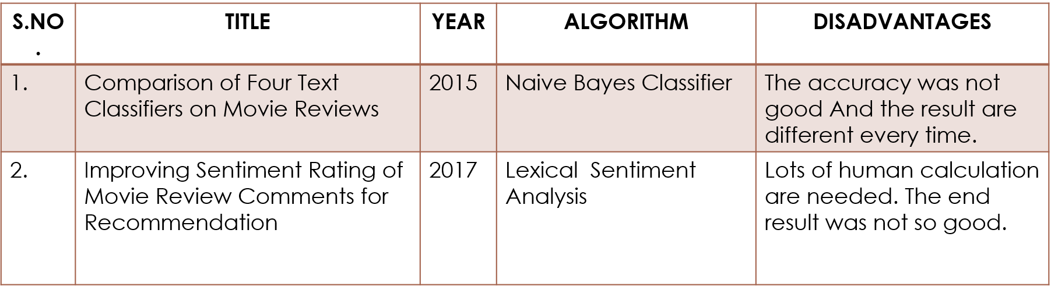
Literature Survey

Slide 6
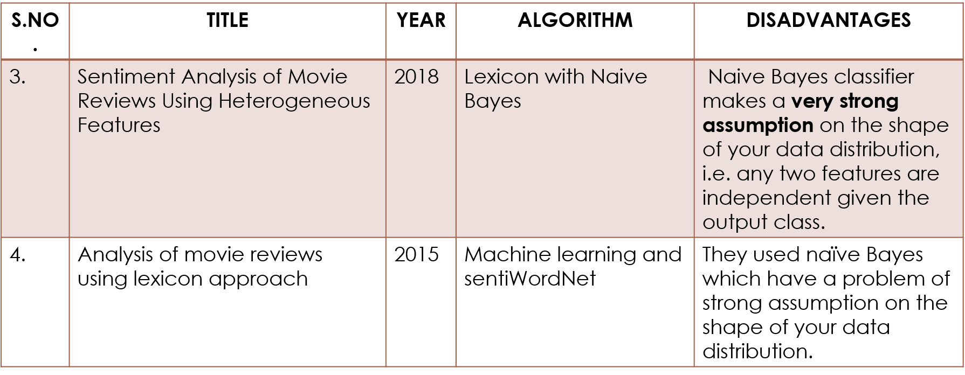

Slide 7
S.NO. | TITLE | YEAR | ALGORITHM | DISADVANTAGES
5. | Sentiment Classiﬁcation of Film Reviews Using IB1 | 2016 | Vector Space model Instance-Based Learning: IB1 using TF-IDF | Long documents are poorly represented because they have poor similarity values.
6. | Enhancing the Performance of Sentiment Analysis by Using Different Feature Combinations | 2018 | Naive Bayes, Support Vector Machine and Maximum Entropy | Theoretically assumes terms are statistically independent. Semantic sensitivity; documents with similar context but different term vocabulary won't be associated, resulting in a "false negative match".

Slide 8
S.NO. | TITLE | YEAR | ALGORITHM | DISADVANTAGES
7. | Sentiment analysis of Indian movie review with various feature selection techniques | 2016 | Bayesian Classiﬁer | It turns out that specifying a prior is extremely difficult.
8. | Sentiment analysis of movie review data using Senti-lexicon algorithm | 2016 | Senti-lexical algorithm | As it is a rule based model lots of computation is needed. Its difficult to implement.

Slide 9
S.NO. | TITLE | YEAR | ALGORITHM | DISADVANTAGES
9. | SentReP: Sentiment Classiﬁcation of Movie Reviews using Efﬁcient Repetitive Pre-Processing | 2013 | K-NN, Naïve Bayes, SVM Linear | They came up with Naïve Bayes being the best algorithm among the others but Naïve Bayes have lots of disadvantage such as data scarcity
10. | Aspect Based Sentiment Analysis of Movie Reviews: Finding the Polarity Directing Aspects | 2014 | Lexicon method | Language cannot be simply divided into different units in real life. Some topics that are traditionally considered advanced can actually be taught at much loser levels

Slide 10
Inference from the survey
Research in semantic analysis has grown significantly in the past few years. It is the emerging field in data mining and Natural Language Processing (NLP) which requires much deeper insight. The relevant works done to solve this problem could be studied through the survey. In this survey it is seen that sentiment analysis play vital role to make decision about the movies. In this project we introduce an Artificial Neural Network (ANN) algorithm.

Slide 11
Objective of the project
Given the availability of a large volume of online review data (Amazon, IMDB, etc.), sentiment analysis becomes increasingly important. In this project, a sentiment classifier is built which evaluates the polarity of a piece of text being either positive or negative.
Semantics is the study of the meaning of linguistic utterances. For their need people are always eager to know other's reviews but, each and every website contains a very huge amount of review text, the normal human reader will have problem in identifying relevant sites, extracting and abstracting the reviews, so they cannot reach to the right decision in less time that is why automated sentiment analysis systems are needed.

Slide 12
Module Description
Artificial Neural Network (ANN):
An Artificial Neural Network (ANN) is an information processing paradigm that is inspired by the way biological nervous systems, such as the brain, process information. The key element of this paradigm is the novel structure of the information processing system. It is composed of a large number of highly interconnected processing elements (neurones) working in unison to solve specific problems. ANNs, like people, learn by example. An ANN is configured for a specific application, such as pattern recognition or data classification, through a learning process. Learning in biological systems involves adjustments to the synaptic connections that exist between the neurones. This is true of ANNs as well.
Neural networks, with their remarkable ability to derive meaning from complicated or imprecise data, can be used to extract patterns and detect trends that are too complex to be noticed by either humans or other computer techniques. A trained neural network can be thought of as an "expert" in the category of information it has been given to analyse.

Slide 13
Advantages:
Adaptive learning: An ability to learn how to do tasks based on the data given for training or initial experience.
Self-Organisation: An ANN can create its own organisation or representation of the information it receives during learning time.
Real Time Operation: ANN computations may be carried out in parallel, and special hardware devices are being designed and manufactured which take advantage of this capability.
Fault Tolerance via Redundant Information Coding: Partial destruction of a network leads to the corresponding degradation of performance. However, some network capabilities may be retained even with major network damage.

Slide 14
Dataset
A data set (or dataset) is a collection of data. Most commonly a data set corresponds to the contents of a single database table, or a single statistical data matrix, where every column of the table represents a particular variable, and each row corresponds to a given member of the data set in question. The data set lists values for each of the variables, such as height and weight of an object, for each member of the data set. Each value is known as a datum. The data set may comprise data for one or more members, corresponding to the number of rows.
This is a dataset for binary sentiment classification containing substantially more data than previous benchmark datasets. it provides a set of 12,500 highly polar movie reviews for training, and 12,500 for testing. There is additional unlabeled data for use as well. Raw text and already processed bag of words formats are provided.

Slide 15
The dataset is compiled from a collection of 25,000 reviews from IMDB on the condition there are no more than 30 reviews per movie. The numbers of positive and negative reviews are equal. Negative reviews have scores less or equal than 4 out of 10 while a positive review have score greater or equal than 7 out of 10. Neutral reviews are not included. The 25,000 reviews are divided evenly into the training and test set.

Slide 16
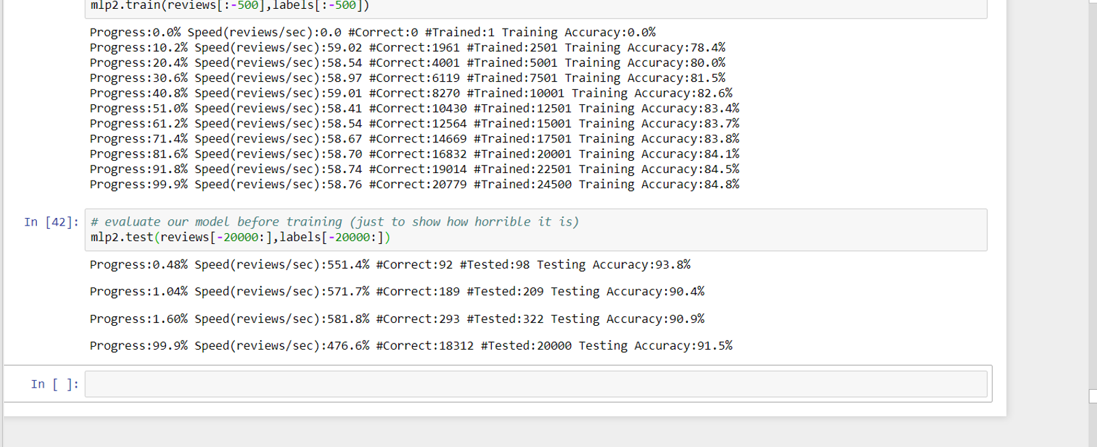
Screenshot of project

Slide 17
References.
[1] Lopamudra Dey, Sanjay Chakraborty, Anuraag Biswas, Beepa Bose, Sweta Tiwari “Sentiment Analysis of Review Datasets using Naïve Bayes’ and K-NN Classifier”. Issue 31-oct-2016
[2] Lina L. Dhande and Dr. Prof. Girish K. Patnaik, “Analyzing Sentiment of Movie Review Data using Naive Bayes Neural Classifier”, IJETTCS, Volume 3, Issue 4 July-August 2014, ISSN 2278-6856.
[3] P.Kalaivani, “Sentiment Classification of Movie Reviews by supervised machine learning approaches” et.al,Indian Journal of Computer Science and Engineering (IJCSE) ISSN : 0976-5166 Vol. 4 No.4 Aug-Sep 2013.
[4] Meena Rambocas, João Gama, “Marketing Research: The Role of Sentiment Analysis”, April 2013, ISSN: 0870-8541.

Slide 18
[5] Weiguo Fan, Linda Wallace, Stephanie Rich, and Zhongju Zhang, “Tapping into the Power of Text Mining”, Journal of ACM, Blacksburg, 2005.
[6] “Movie review dataset,” [Online]. Available http://www.cs.cornell.edu/people/pabo/movie-reviewdata/, [Accessed: October 2013].
[7] K. M. Leung, “Naive Bayesian classifier,” [Online] Available: http://www.sharepdf.com/81fb247fa7c54680a94dc0f3a 253fd85/naiveBayesianClassifier.pdf, [Accessed: September 2013].

Slide 19
THANK YOU

